Slide 1
Data Link Layer
Data Communictions and Networking1/ 109

Slide 2
Data Link Layer Services
Data Communictions and Networking2/ 109

Slide 3

Introduction to Datalink Layer and its Services
In the OSI model,DLL is a 4thlayer from the top and 2nd layer from the bottom.
The communication channel that connects the adjacent nodes is known aslinks, and in order to move the datagram from source to the destination, the datagram must be moved across an individual link.
The main responsibility of the DLL is to transfer the datagram across an individual link.
The DLL protocol defines the format of the packet exchanged across the nodes as well as the actions such asError Correction and Detection,Retransmission,Flow control, andRandom access.
The DLL protocols areEthernet,Token ring,FDDIandPPP.
An important characteristic of a DLL is that datagram can be handled by different link layer protocols on different links in a path. For example, the datagram is handled by Ethernet on the first link, PPP on the second link.
/ 109

Slide 4
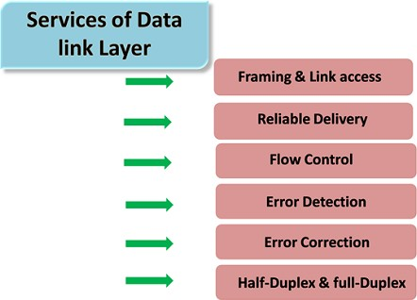
DLL Services

Slide 5
Flow Control
It is a technique that allows two stations working at different speeds to communicate with each other.
It is a set of measures taken to regulate the amount of data that a sender sends so that a fast sender does not overwhelm a slow receiver.
In DLL, It restricts the number of frames the sender can send before it waits for an acknowledgment from the receiver.

Slide 6
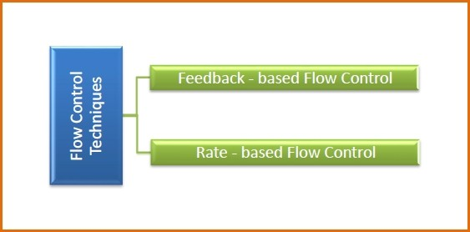
Approaches of Flow Control
Feedback-Based Flow Control: The sender sends frames after it has received acknowledgments from the user.
Rate-Based Flow Control: They have built in mechanisms to restrict the rate of transmission of data without requiring acknowledgment from the receiver.

Slide 7
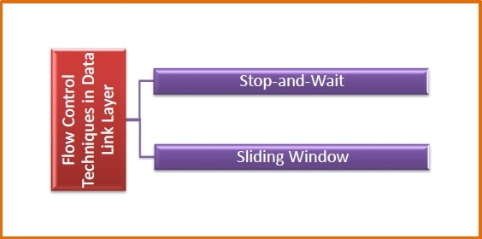
Flow Control Techniques
Flow Control : Coordinates the amount of data that can be sent before receiving acknowledgement.
1
Stop and Wait: The sender sends a frame and waits for acknowledgment. Once received the next frame is sent. (i.eOne frame at a time).
2
Sliding Window: Both Sender and Receiver agrees upon the number of frames to be sent based upon the buffer size (Window). (i.eSeveral frames at a time)

Slide 8
Stop-and-Wait Flow Control
It is the simplest form of flow control.
In this method the message is broken into multiple frames, and the receiver indicates its readiness to receive a frame of data.
The sender waits for a receipt acknowledgement (ACK) after every frame for a specified time (called a time out).
The receiver sends the ACK to let the sender know that the frame of data was received correctly.
The sender will then send the next frame only after the ACK.
Operations :
Sender: Transmits a single frame at a time. Sender waits to receive ACK within time out.
Receiver: Transmits acknowledgement (ACK) as it receives a frame. Go to step 1 when ACK is received, or time out is hit.
1
2
3
4

Slide 9
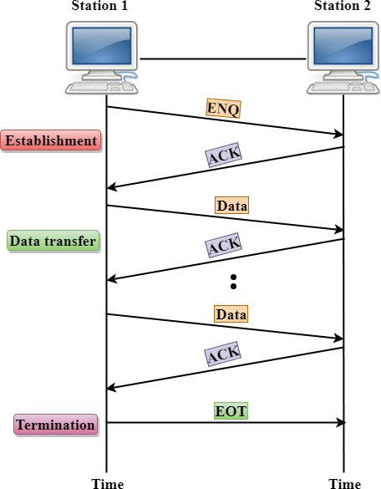
Stop-and-Wait Flow Control
Pros: The only advantage of this method of flow control is its simplicity
Cons: The sender needs to wait for the ACK after every frame it transmits. This is a source of inefficiency, and is particularly bad when the propagation delay is much longer than the transmission delay.
Stop and wait can also create inefficiencies when sending longer transmissions

Slide 10
Sliding-Window Flow Control-I
In this, a sender can transmit the several frames before getting an acknowledgement.
Since, multiple frames are sent one after the another due to which capacity of the communication channel can be utilized efficiently.
A single ACK acknowledge multiple frames.
The window can hold the frames at either end, and it provides the upper limit on the number of frames that can be transmitted before the acknowledgement.
Frames can be acknowledged even when the window is not completely filled.
The window has a specific size in which they are numbered as modulo-n means that they are numbered from 0 to n-1.
For example, if n = 8, the frames are numbered from 0,1,2,3,4,5,6,7,0,1,2,3,4,5,6,7,0,1........

Slide 11
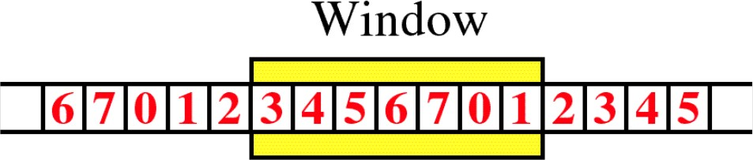
Sliding-Window Flow Control-II
The size of the window is represented as n-1. Therefore, maximum n-1 frames can be sent before acknowledgement.
When the receiver sends the ACK, it includes the number of the next frame that it wants to receive. For example, to acknowledge the string of frames ending with frame number 4, the receiver will send the ACK containing the number 5. When the sender sees the ACK with the number 5, it got to know that the frames from 0 through 4 have been received.

Slide 12
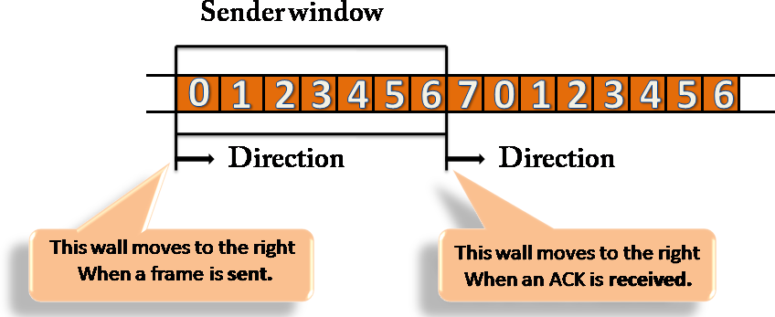
Sender Window
At the beginning of a transmission, the sender window contains n-1 frames, and when they are sent out, the left boundary moves inward shrinking the size of the window.
For example, if the size of the window is w=7 if three frames are
sent out, then the number of frames left out in the sender window is w-3. Once the ACK has arrived, then the sender window expands to the number which will be equal to the number of frames acknowledged by ACK.

Slide 13
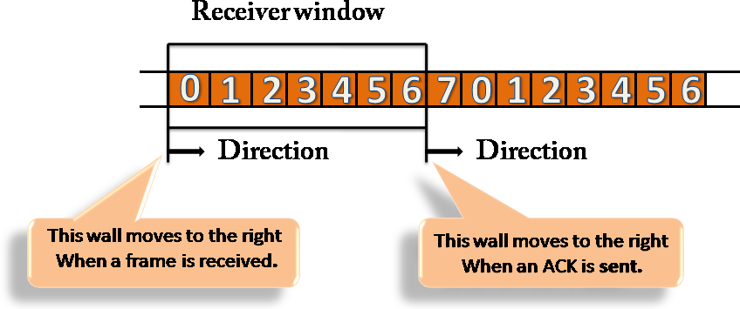
Receiver Window
At the beginning of transmission, the receiver window does not contain n frames, but it contains n-1 spaces for frames.
When the new frame arrives, the size of the window shrinks.
The receiver window does not represent the number of frames received, but it represents the number of frames that can be received before an ACK is sent. For example, the size of the window is w, if three frames are received then the number of spaces available in the window is (w-3).
Once the acknowledgment is sent, the receiver window expands by the number equal to the number of frames acknowledged.

Slide 14
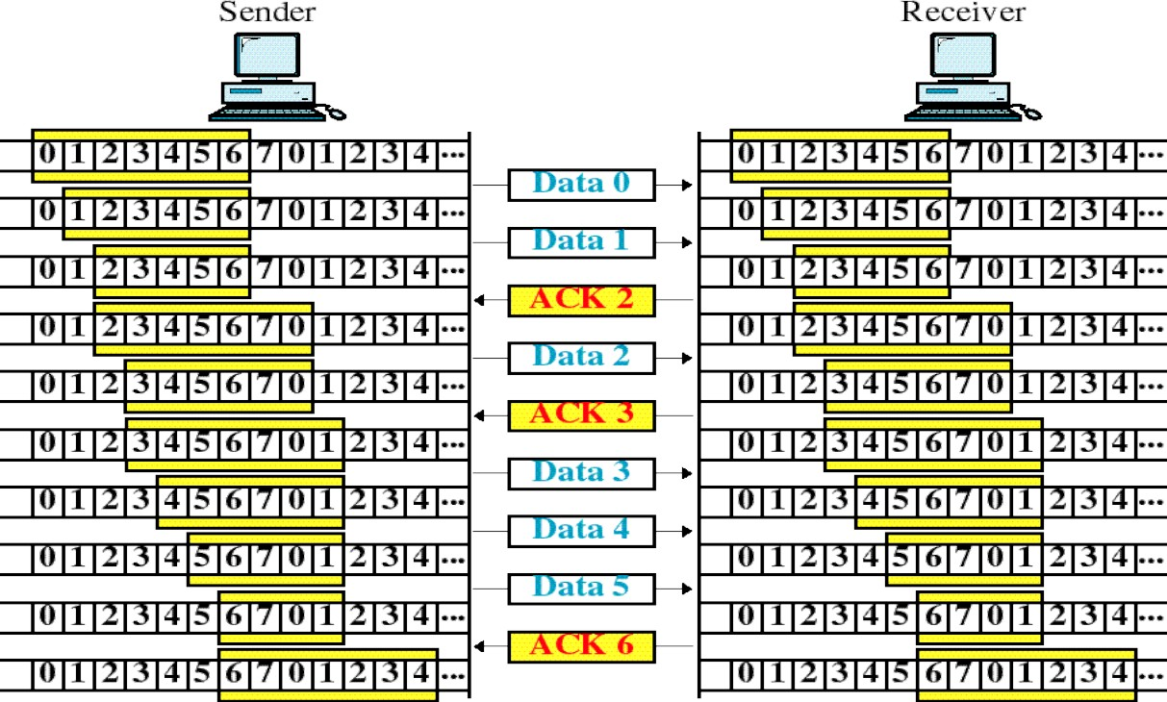
Example : Sliding Window Protocol

Slide 15
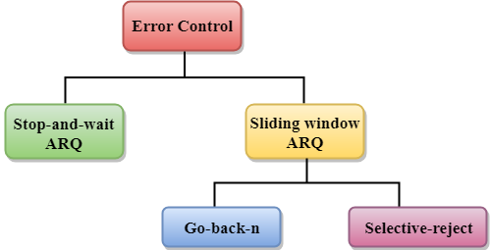
Error Control in DLL
Error Control is a technique of error detection and retransmission and broadly classified as below
Note:ARQ → Automatic Repeat Request

Slide 16
Stop-and-Wait ARQ
It is used to retransmit the data in case of damaged or lost frames.
It is used whenStop-and-WaitFlow Control Protocol is used. Two possibilities of the retransmission:
Damaged Frame: When the receiver receives a damaged frame, i.e., the frame contains an error, then it returns the NACK frame.
Lost Frame: Sender is equipped with the timer and starts when the frame is transmitted. Sometimes the frame has not arrived at the receiving end so that it can be acknowledged neither positively nor negatively. The sender waits for acknowledgement until the timer goes off. If the timer goes off, it retransmits the last transmitted frame.

Slide 17
Stop-and-Wait ARQ
Four Features required for Retransmission :
The sending device keeps a copy of the last transmitted frame until the acknowledgement is received. Keeping the copy allows the sender to retransmit the data if the frame is not received correctly.
Both the data frames and the ACK frames are numbered alternately 0 and 1 so that they can be identified individually. Suppose data 1 frame acknowledges the data 0 frame means that the data 0 frame has been arrived correctly and expects to receive data 1 frame.
If an error occurs in the last transmitted frame, then the receiver sends the NAK frame which is not numbered. On receiving the NAK frame, sender retransmits the data.
It works with the timer. If the acknowledgement is not received within the allotted time, then the sender assumes that the frame is lost during the transmission, so it will retransmit the frame.

Slide 18
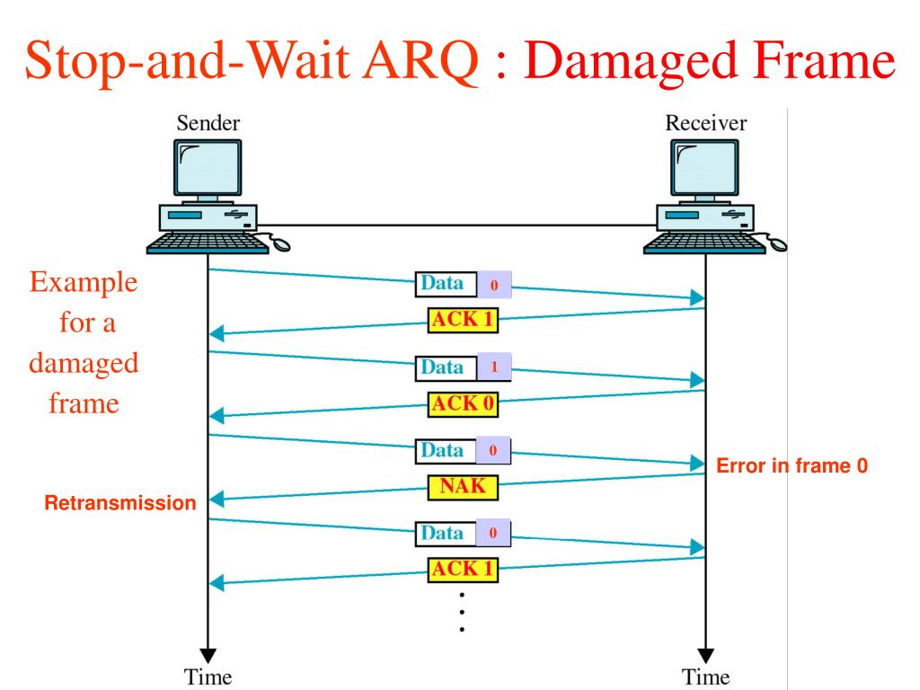

Slide 19
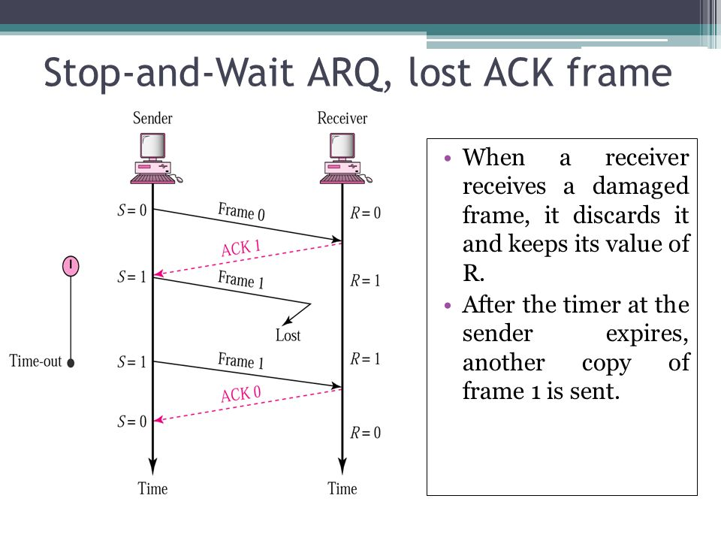

Slide 20
Sliding-Window ARQ
It is a technique used for continuous transmission error control. Three Features used for retransmission:
In this case, the sender keeps the copies of all the transmitted frames until they have been acknowledged. Suppose the frames from 0 through 4 have been transmitted, and the last acknowledgement was for frame 2, the sender has to keep the copies of frames 3 and 4 until they receive correctly.
The receiver can send either NAK or ACK depending on the conditions. The NAK frame tells the sender that the data have been received damaged. Since the sliding window is a continuous transmission mechanism, both ACK and NAK must be numbered for the identification of a frame.
The ACK frame consists of a number that represents the next frame which the receiver expects to receive. The NAK frame consists of a number that represents the damaged frame.

Slide 21
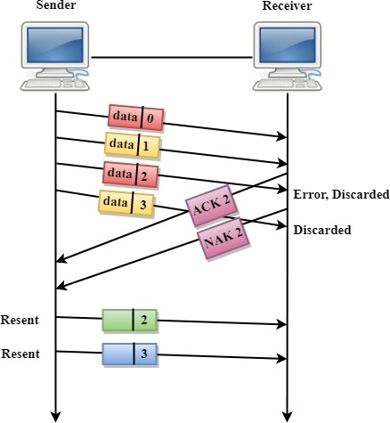
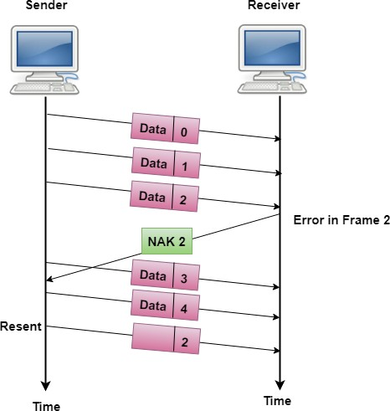
Types of ARQ in Sliding Window Protocol
Go-Back-n ARQ: if one frame is lost or damaged, then it retransmits all the frames after which it does not receive the positive ACK.
Selective-Repeat ARQ: It retransmits only the frame lost or damaged.
Figure:Go-Back
Figure:Select-Repeat

Slide 22
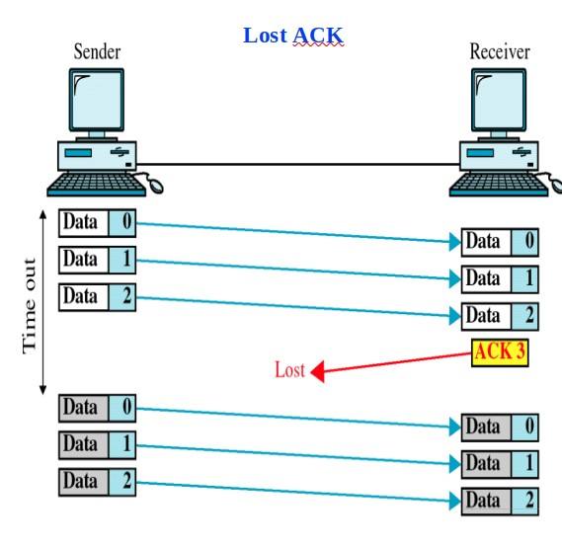
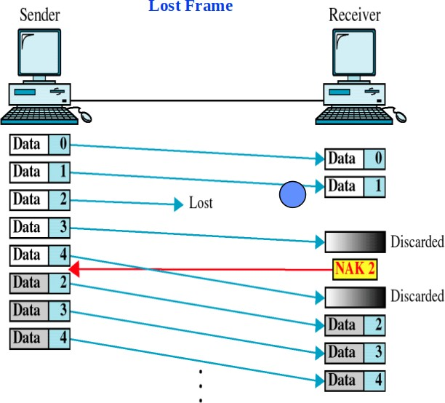
Frame/Acknowledge Lost
Figure:Go-Back N
Figure:Go-Back N

Slide 23
Sliding Window ARQ – Go-Back-n ARQ
Damaged Frame

Slide 24
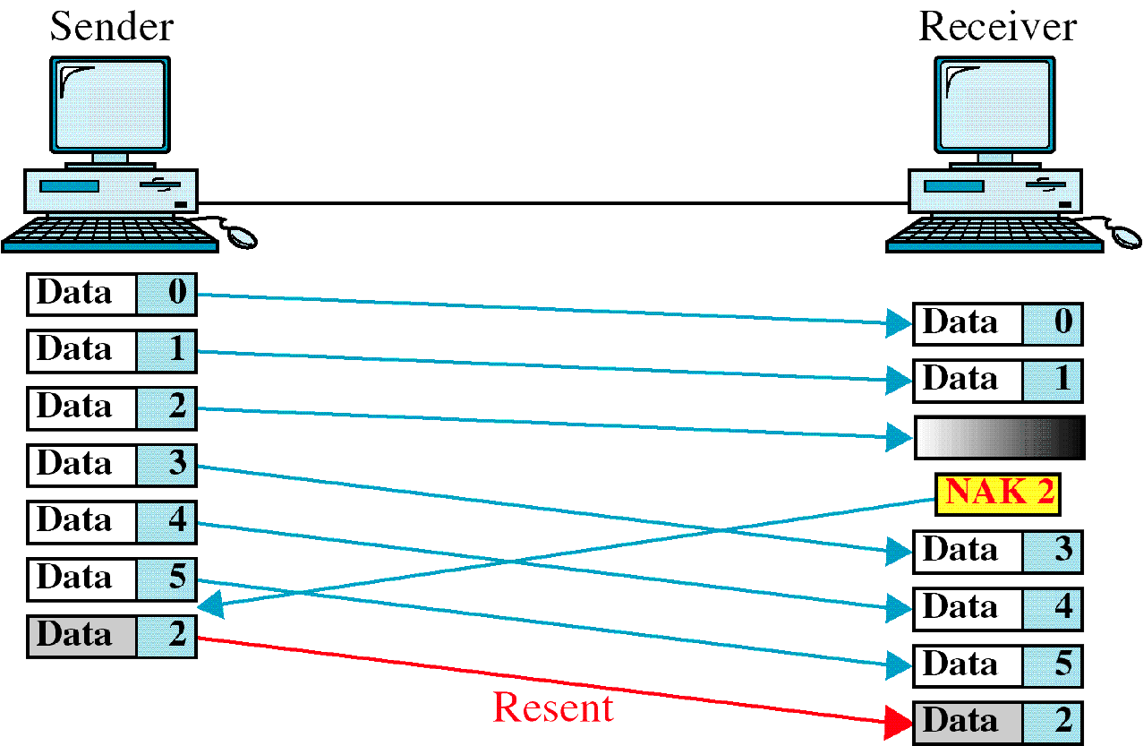
Damaged Frame

Slide 25
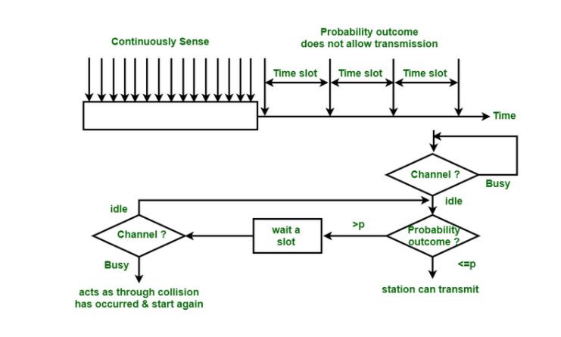
P-persistent CSMA

Slide 26
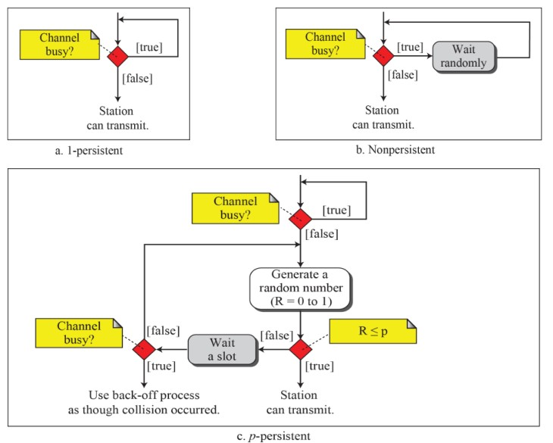
Flow Diagrams of three persistent methods
Data Communictions and Networking26/ 109

Slide 27
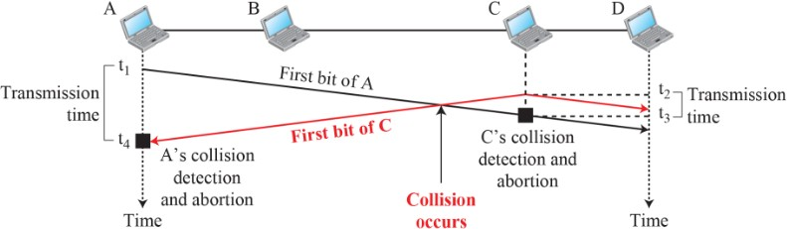
2.1 CSMA/CD
The CSMA method does not specify the procedure following a collision.
Carrier sense multiple access with collision detection (CSMA/CD) augments the algorithm to handle the collision.
In this method, a station monitors the medium after it sends a frame to see if the transmission was successful. If so, the station is finished. If, however, there is a collision, the frame is sent again.
Data Communictions and Networking27/ 109

Slide 28
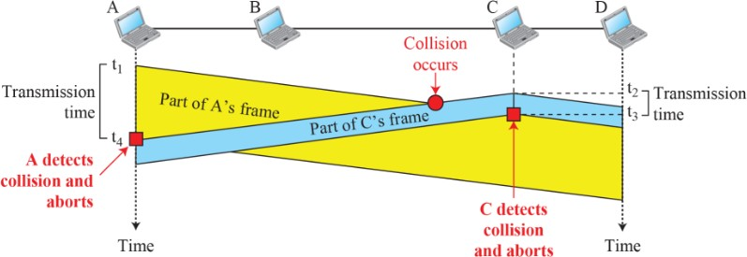
Collision and abortion in CSMA/CD
Data Communictions and Networking28/ 109

Slide 29
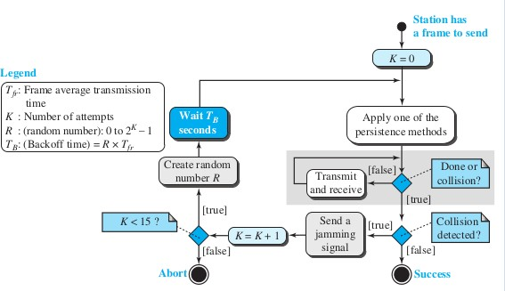
Flow Diagram CSMA/CD
Data Communictions and Networking29/ 109

Slide 30
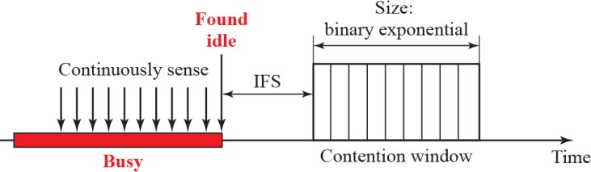
2.2 CSMA/CA
Carrier sense multiple access with collision avoidance (CSMA/CA) was invented for wireless networks.
Collisions are avoided through the use of CSMA/CA’s three strategies:
The interframe space (DIFS & SIFS), The contention window, and
Control frames (RTS, CTS, ACK).
Data Communictions and Networking30/ 109

Slide 31
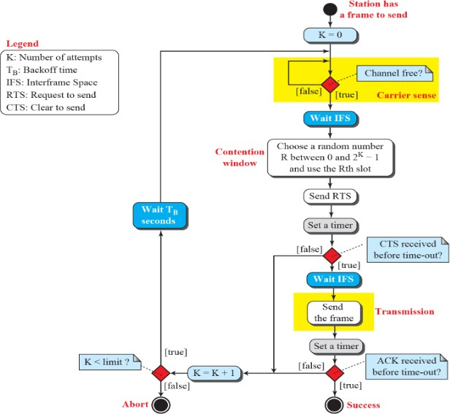
Flow Diagram of CSMA/CA
Data Communictions and Networking31/ 109

Slide 32
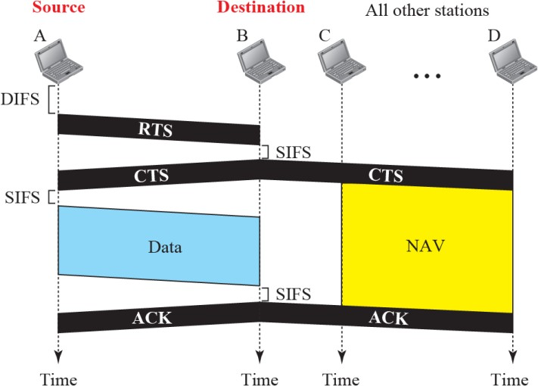
CSMA/CA and NAV
Data Communictions and Networking32/ 109

Slide 33
Controlled Access
In controlled access, the stations consult one another to find which station has the right to send.
A station cannot send unless it has been authorized to send. Controlled Access Types :
Reservation. Polling.
Token Passing.
Data Communictions and Networking33/ 109

Slide 34
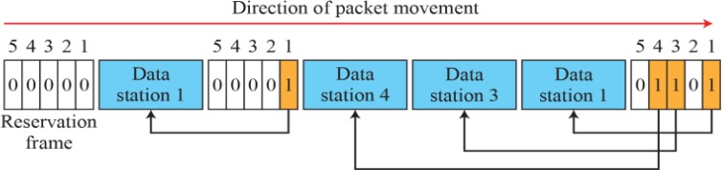
1. Reservation
Here, a station needs to make a reservation before sending data. Time is divided into intervals. In each interval, a reservation frame precedes the data frames sent in that interval.
If there are N stations in the system, there are exactly N reservation minislots in the reservation frame. Each minislot belongs to a station. When a station needs to send a data frame, it makes a reservation in its own minislot. The stations that have made res- ervations can send their data frames after the reservation frame.
Data Communictions and Networking34/ 109

Slide 35
2. Polling
Polling works with topologies in which one device is designated as a primary station and the other devices are secondary stations.
All data exchanges must be made through the primary device even when the ultimate destination is a secondary device.
The primary device controls the link; the secondary devices follow its instructions.
It is up to the primary device to determine which device is allowed to use the channel at a given time.
Primary Station :
SEL = select, used by the primary device when it wishes to send POL = used to solicit transmission from secondary devices
ACK = acknowledge receipt from a secondary device
Secondary Station:
ACK = acknowledge receipt from primary device
NACK = non-ACK is used when there is nothing to send.
Data Communictions and Networking35/ 109

Slide 36
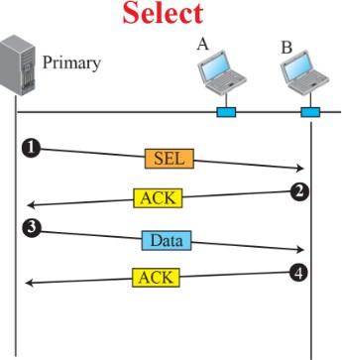
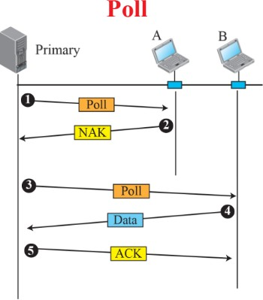
Select and Poll functions
Data Communictions and Networking36/ 109

Slide 37
3. Token Passing
Stations in this network are organized in a logical ring: there is a predecessor and a successor to each node.
The predecessor is the station which is logically before the station in the ring; the successor is the station which is after the station in the ring.
A special packet called a token moves from station to station. A station can only send messages while it holds the token.
The token can be held for a limited amount of time before it is sent to the successor. Priorities can be configured by setting a different holding time for each station.
The dual ring, common with the FDDI implementation, allows for some redundancy if there is a failure on one of the rings.
Each node on the ring must be able to re-generate the token if the token is lost or damaged.
The ring is vulnerable to loss of a station unless the star ring is used. The central hub of a star ring is called an MAU (multi-access unit)
Data Communictions and Networking37/ 109

Slide 38
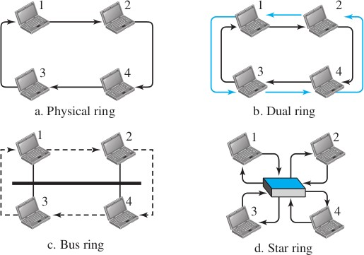
Logical Ring and Physical Topology
Data Communictions and Networking38/ 109

Slide 39
Channelization
Channelization is a multiple-access method where the available bandwidth of a link is shared among stations by
Time Frequency Code
Three common channelization protocols are TDMA = Time Division Multiple Access FDMA = Frequency Division Multiple Access CDMA = Code Division Multiple Access
Data Communictions and Networking39/ 109

Slide 40
FDMA - FDM Access
FDMA divides the available bandwidth into frequency bands.
Each station is allocated a band of frequencies for data transmission.
FDM
FDM is at the physical layer, combining low bandwidth channels into a high bandwidth channel.
Used for the first generation analog mobile phone system.
FDMA
FDMA is at the data-link layer.
Each station always uses the same band.
Each stations transmits over the shared link media without a multiplexer.
Bandpass filters are used at the stations to separate the signals.
Data Communictions and Networking40/ 109

Slide 41
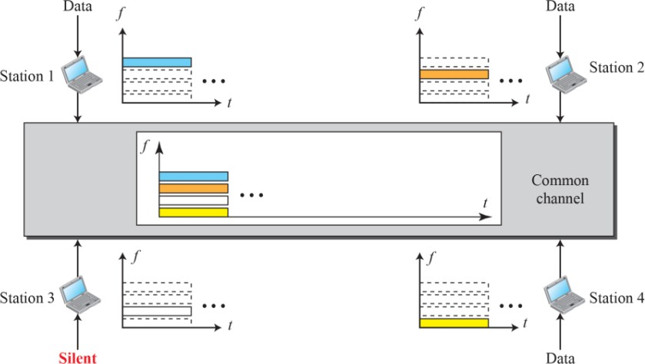
FDMA -
Data Communictions and Networking41/ 109

Slide 42
TDMA - TDM Access
Time-Division Multiple Access (TDMA) is where stations share bandwidth in time.
Each station is allocated a time slot during which it can send data. Each station transmits its data in its assigned time slot.
This requires all the stations be synchronize
TDM operates at the physical layer.
Low bandwidth channels are combined into a high bandwidth channel using a multiplexer.
TDMA operates at the data-link layer.
Stations transmit through one shared channel
Each station transmits when its assigned time slot is available
Data Communictions and Networking42/ 109

Slide 43
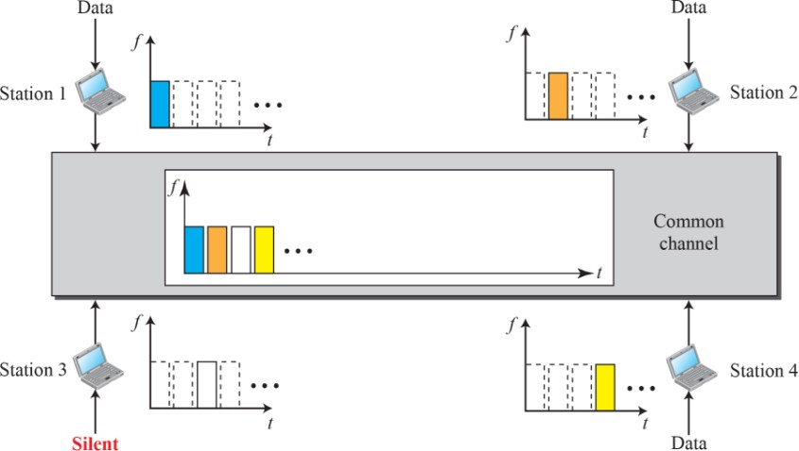
TDMA - TDM Access
Data Communictions and Networking43/ 109

Slide 44
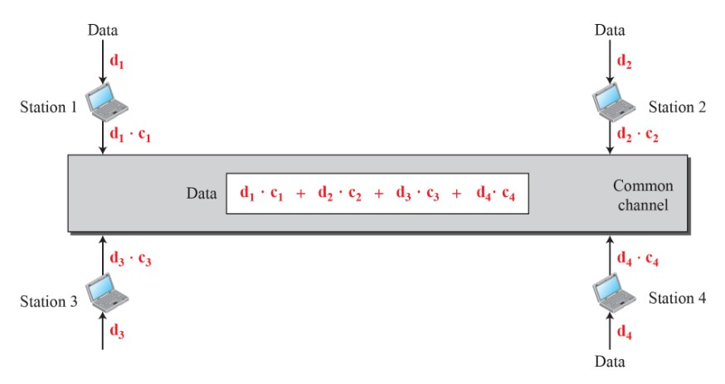
CSMA - CSM Access
It was conceived several decades ago.
Advances in electronic technology have made its implementation possible.
CDMA differs from FDMA and TDMA in that all stations transmit
simultaneously each using all the available frequency bandwidth.
Data Communictions and Networking44/ 109

